Slide 1
Investigation into Post Pandemic Education Emmett Lawlor 18238831 John Nelson
LM118: BEng in Electronic and Computer Engineering
Spring semester 2022 Final Presentation

Slide 2
Presentation overview
Overview
Key Work Dates
Key results
Problems and Solutions
Potential uses of the system and future work
Demonstration
Conclusions

Slide 3
Project overview (1)
Fully realised method of extracting course data from Qualifax and UL.
Using frameworks for Python, I created 2 types of scrapers, which read HTML from webpages and save it in a JSON format for easy indexing and use across internet.
Fully realised Webapp used almost 600 times over 2 semesters.
Using timetable data I could recreate events into a Universal Calendar Format.
Fully realised an analytical report investigating points data nationally and module data in UL.
Using Qualifax, UL and CAO data, I investigated some trends we saw during the pandemic.

Slide 4
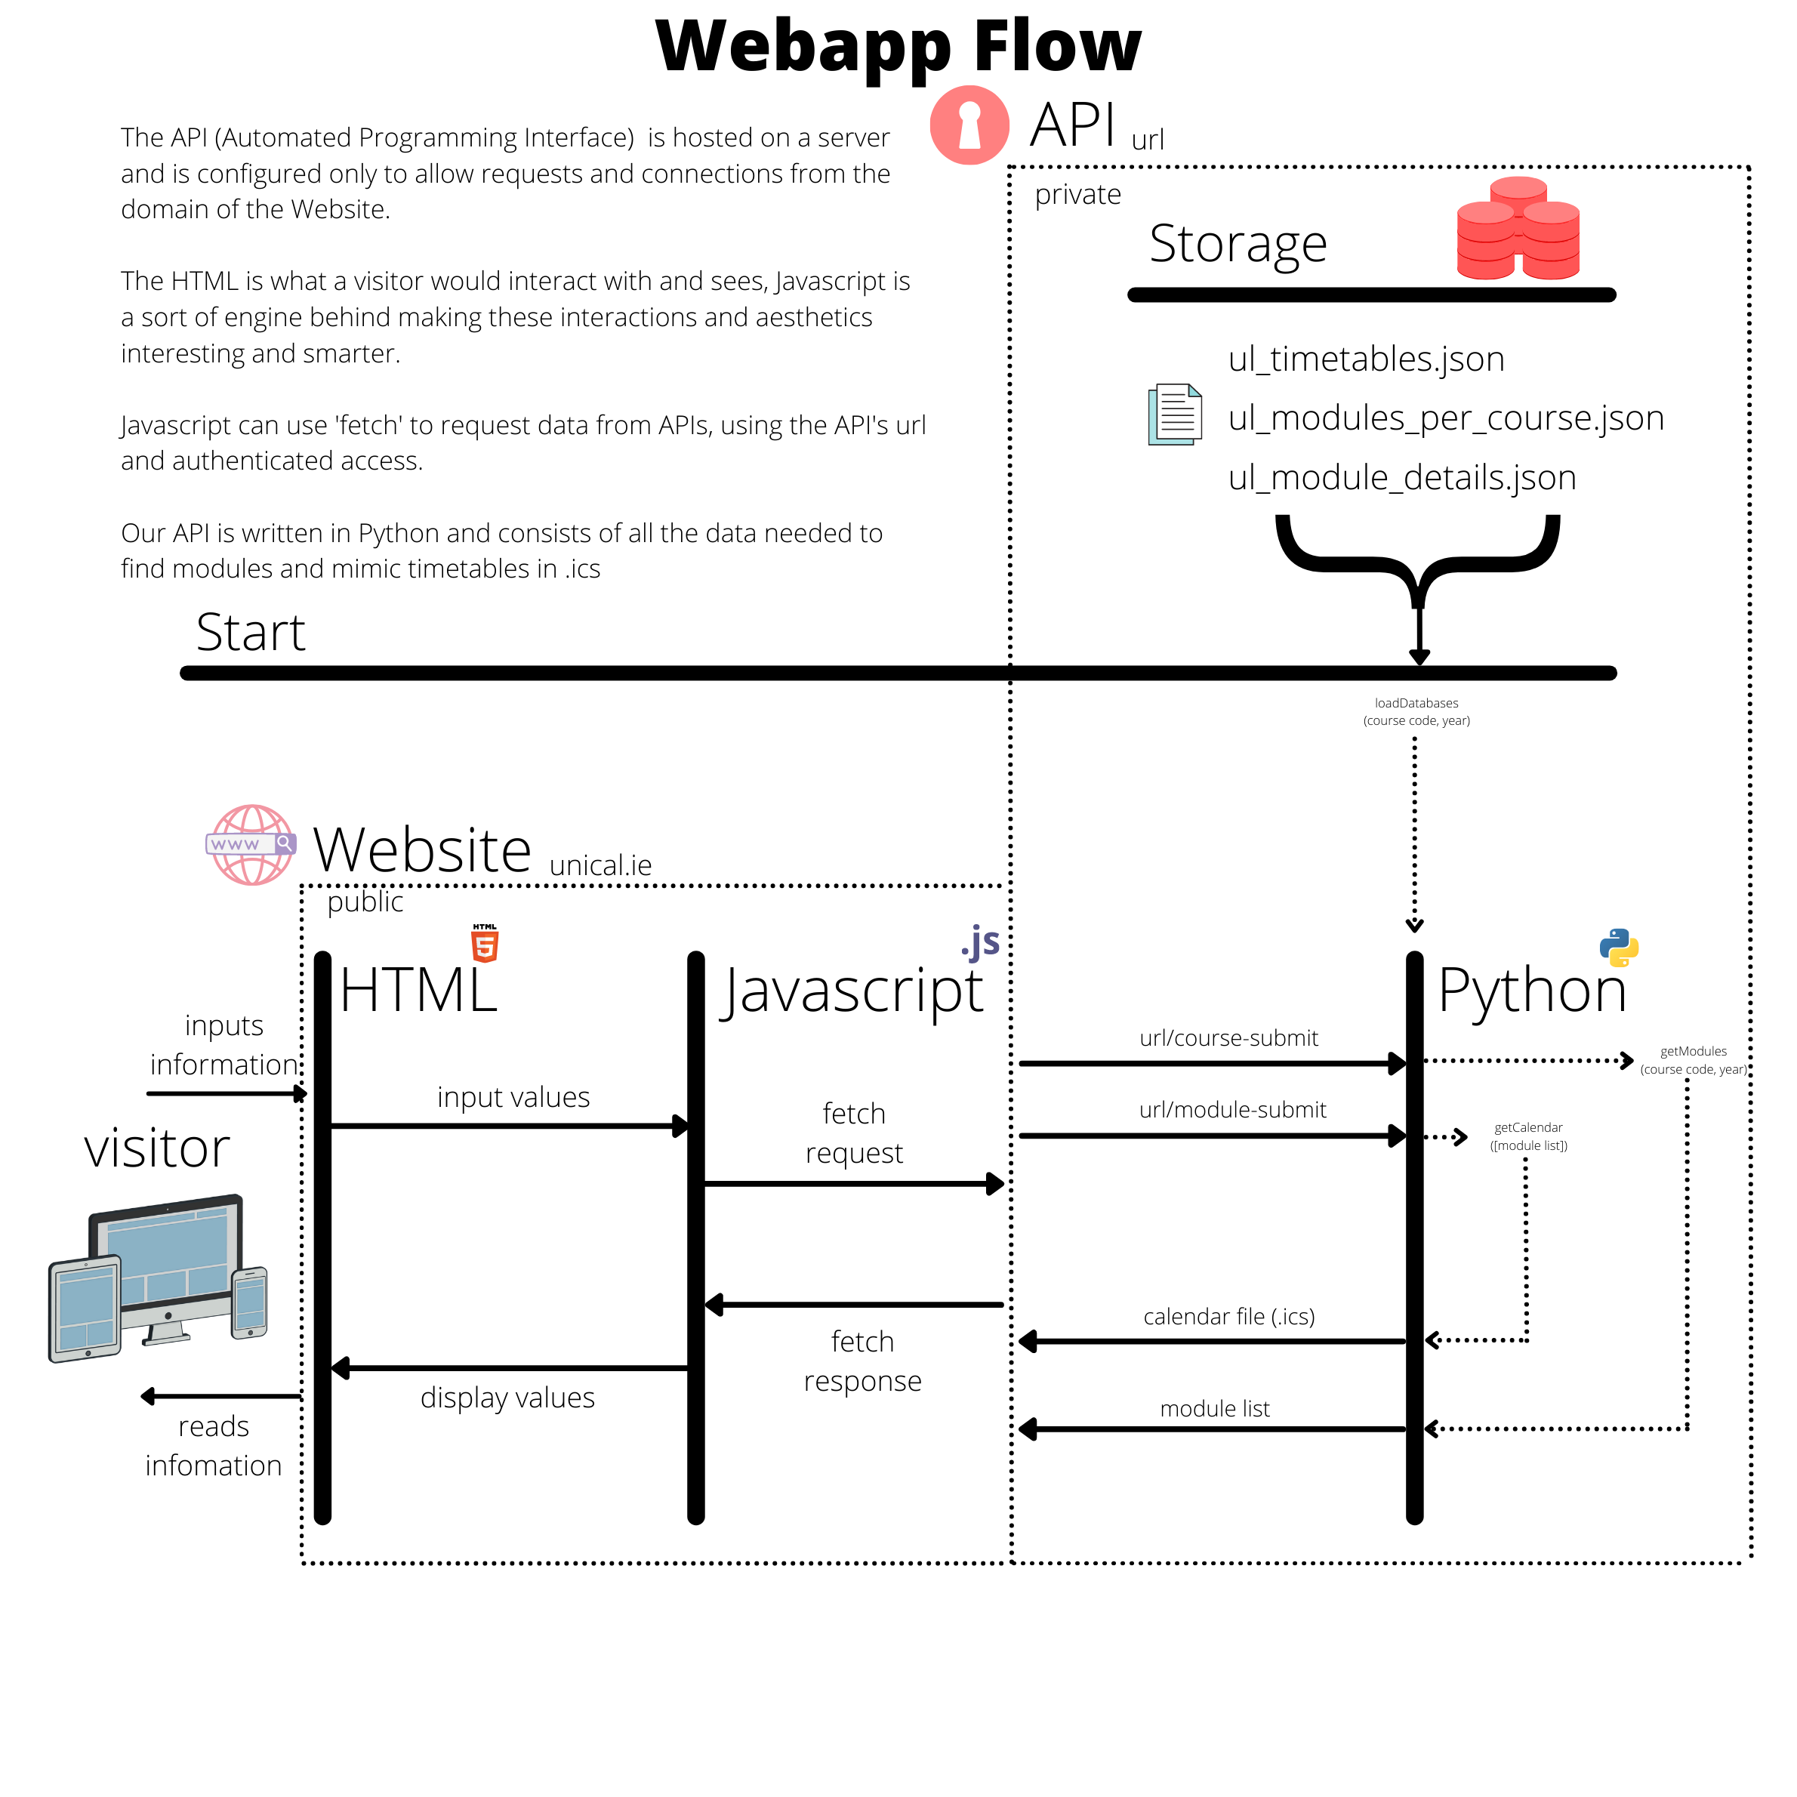
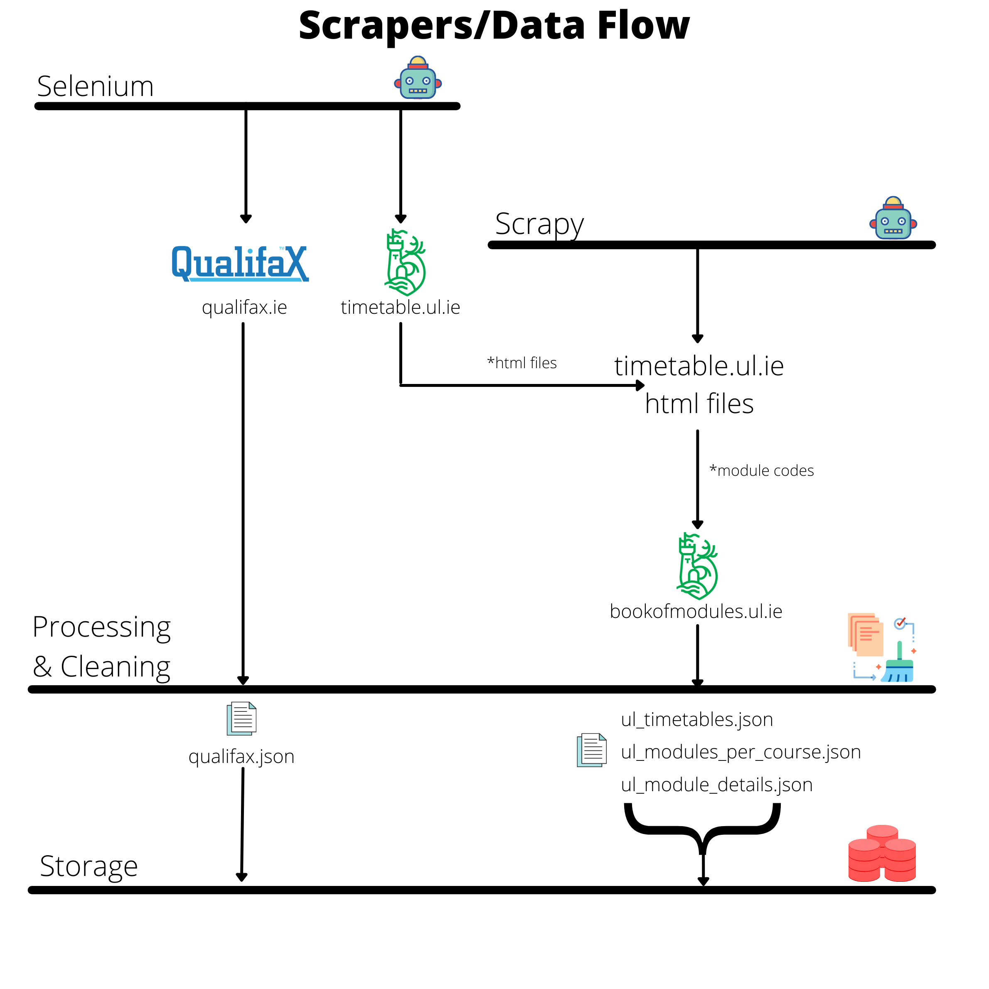
Project overview (2)

Slide 5
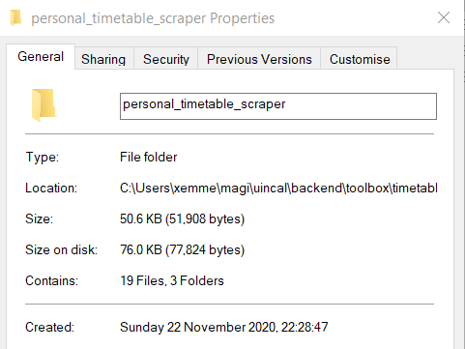
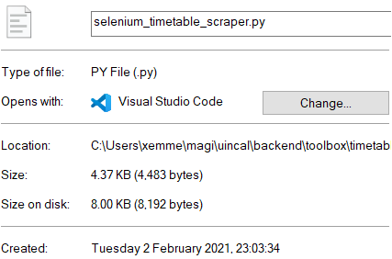
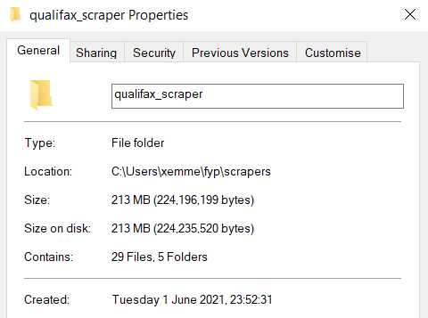
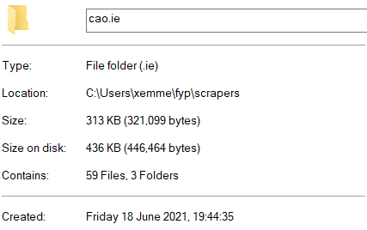
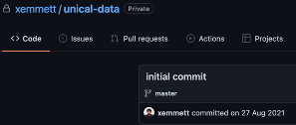
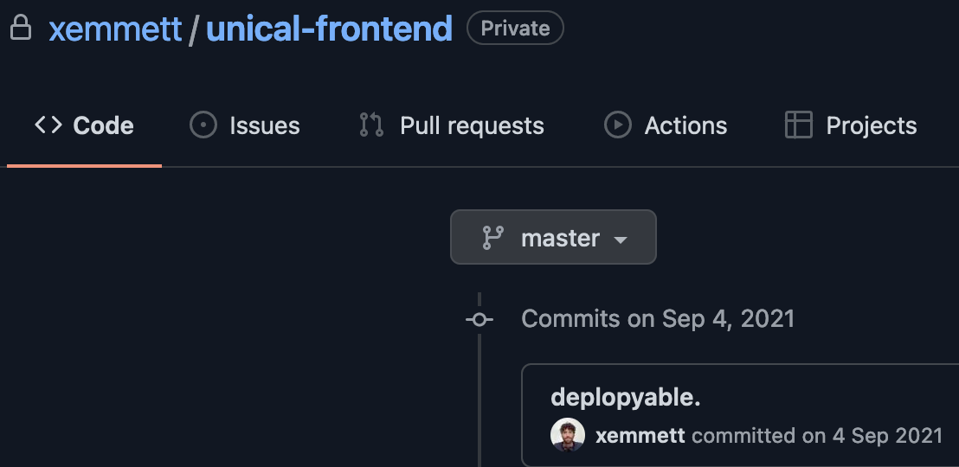
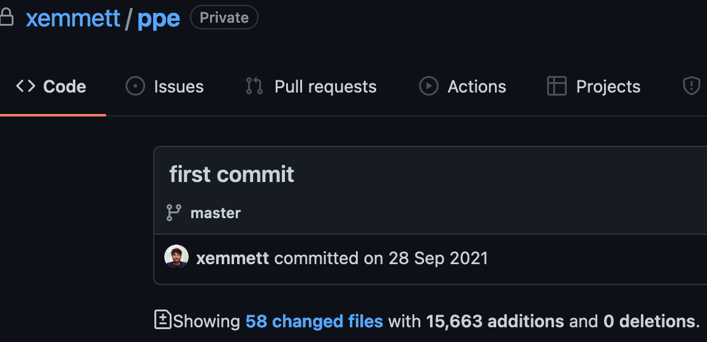
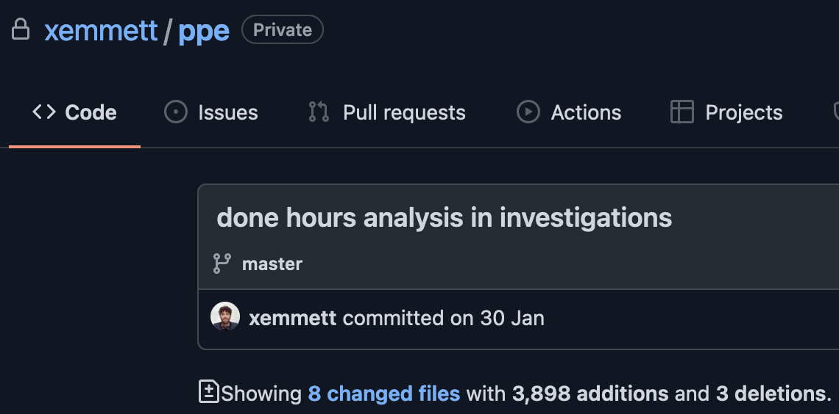
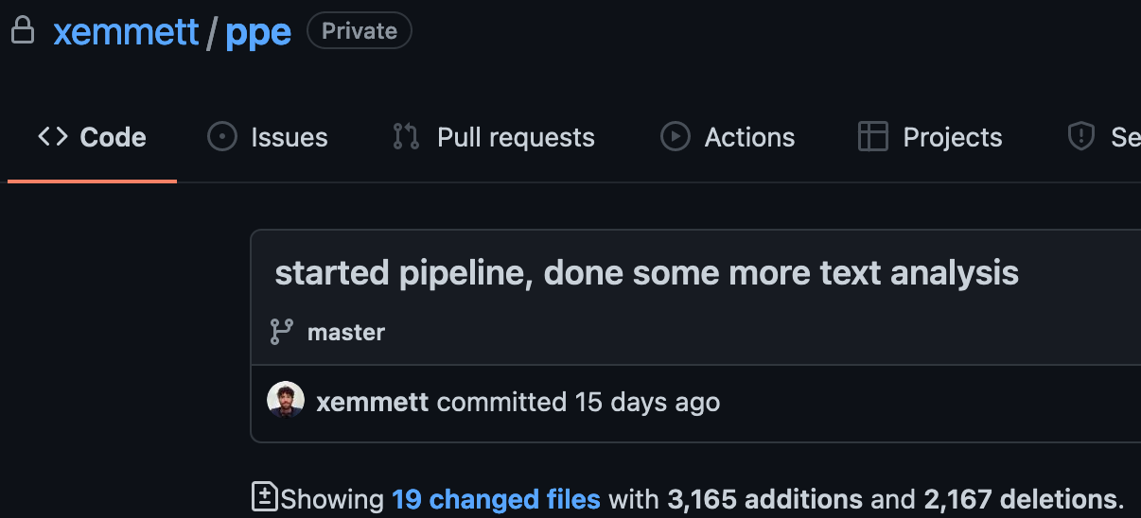
Key work dates
Started Personal Timetable Scraper
Started Course Timetable Scraper
Started Qualifax Scraper
Started CAO investigation
Deployed Webapp API
Deployed Webapp Front-end
ppe ~ fyp
Post Pandemic Education / Personal Protective Equipment
UL Timetable vs Bookofmodules
Hours analysis
Axed keyword analysis

Slide 6
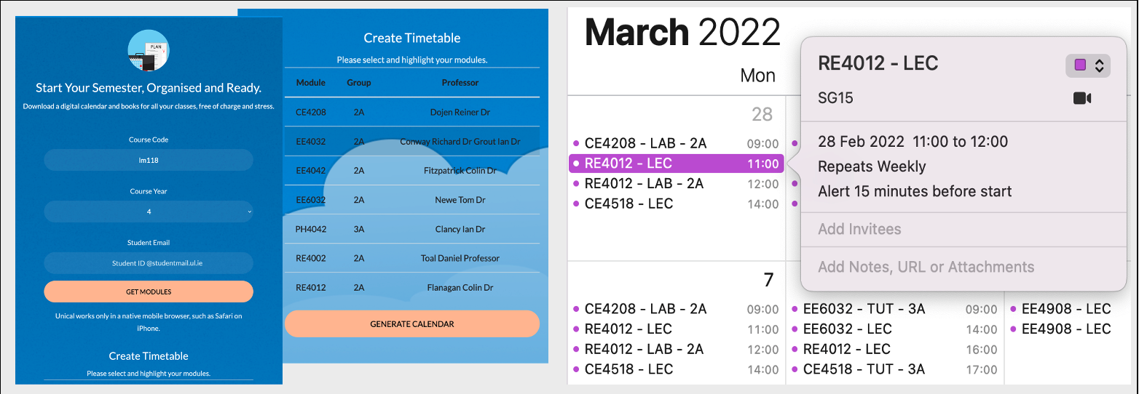
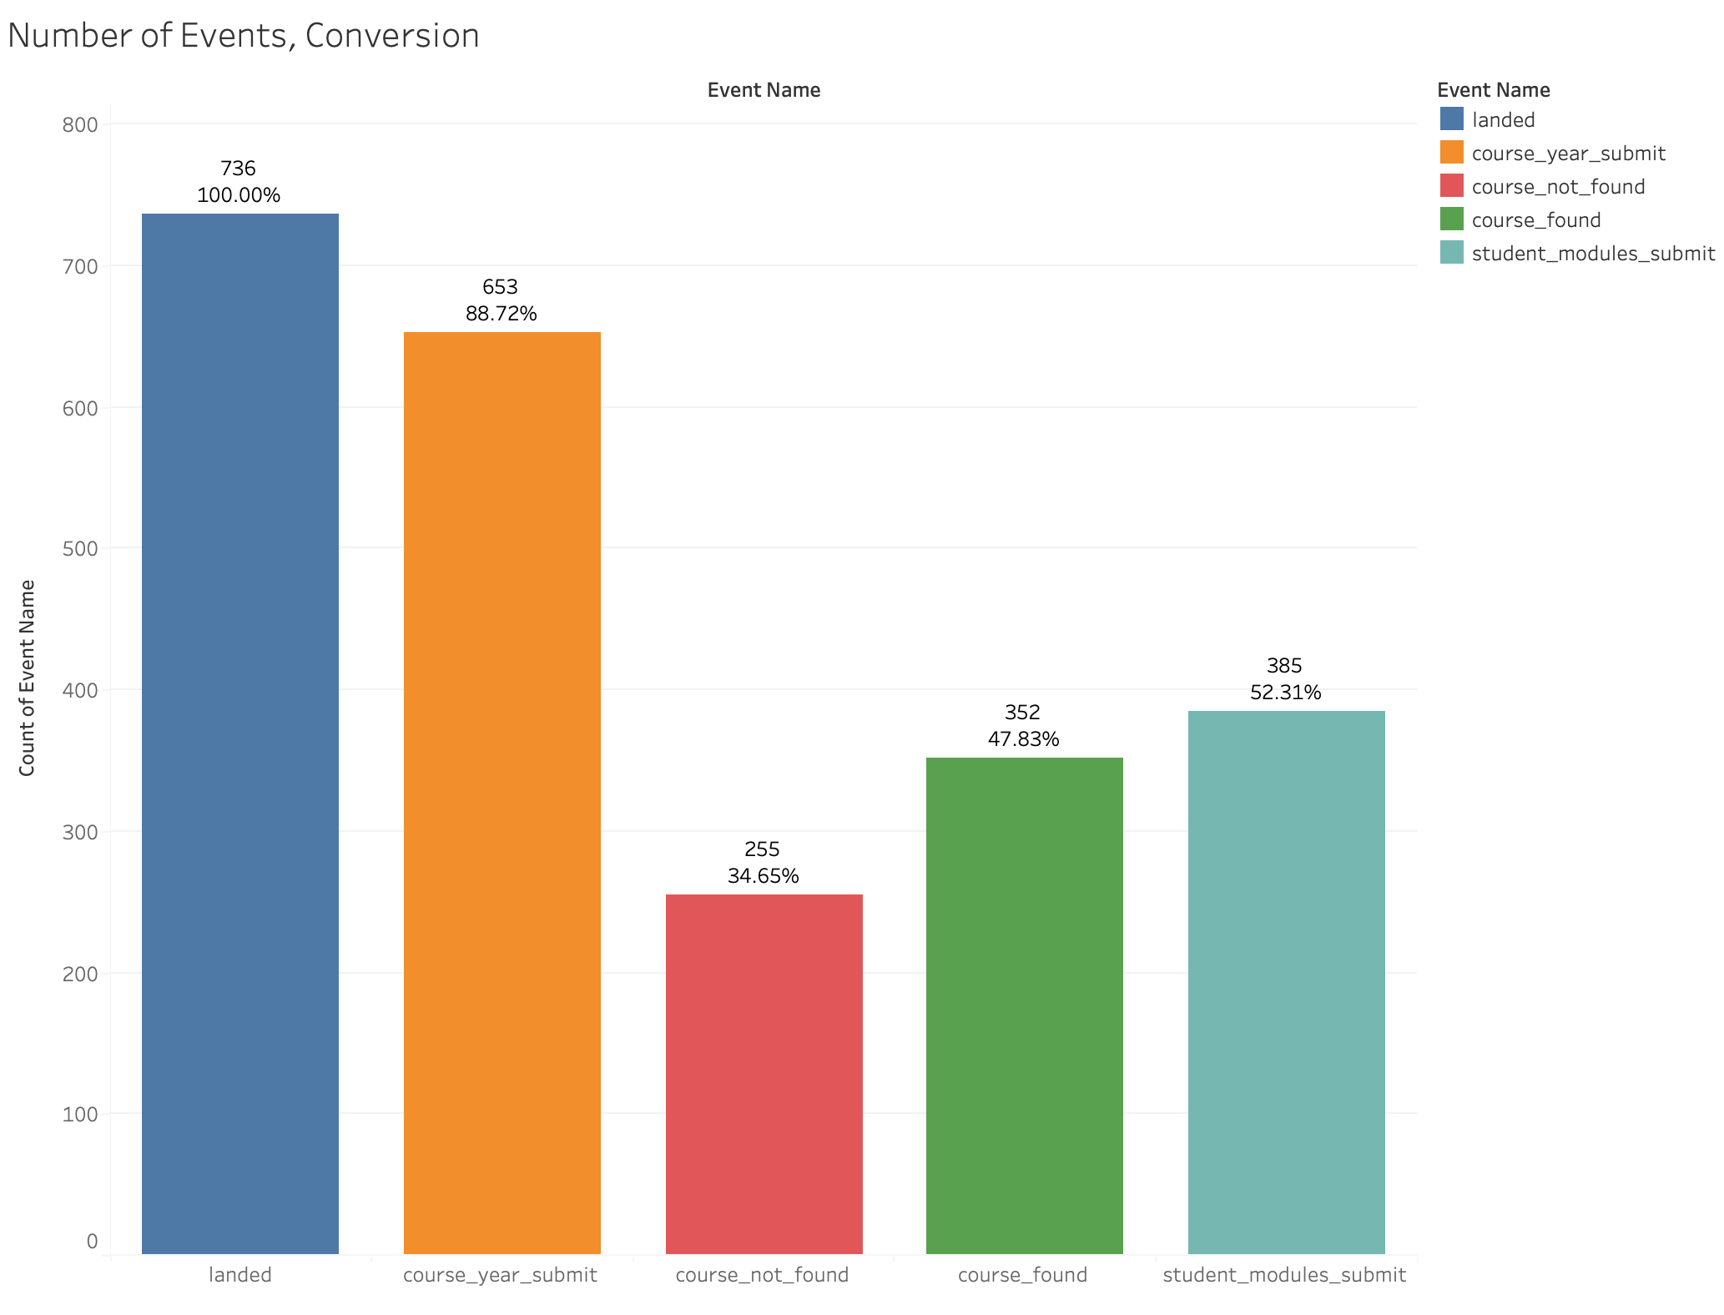
Key results
Fully functional webapp

Slide 7
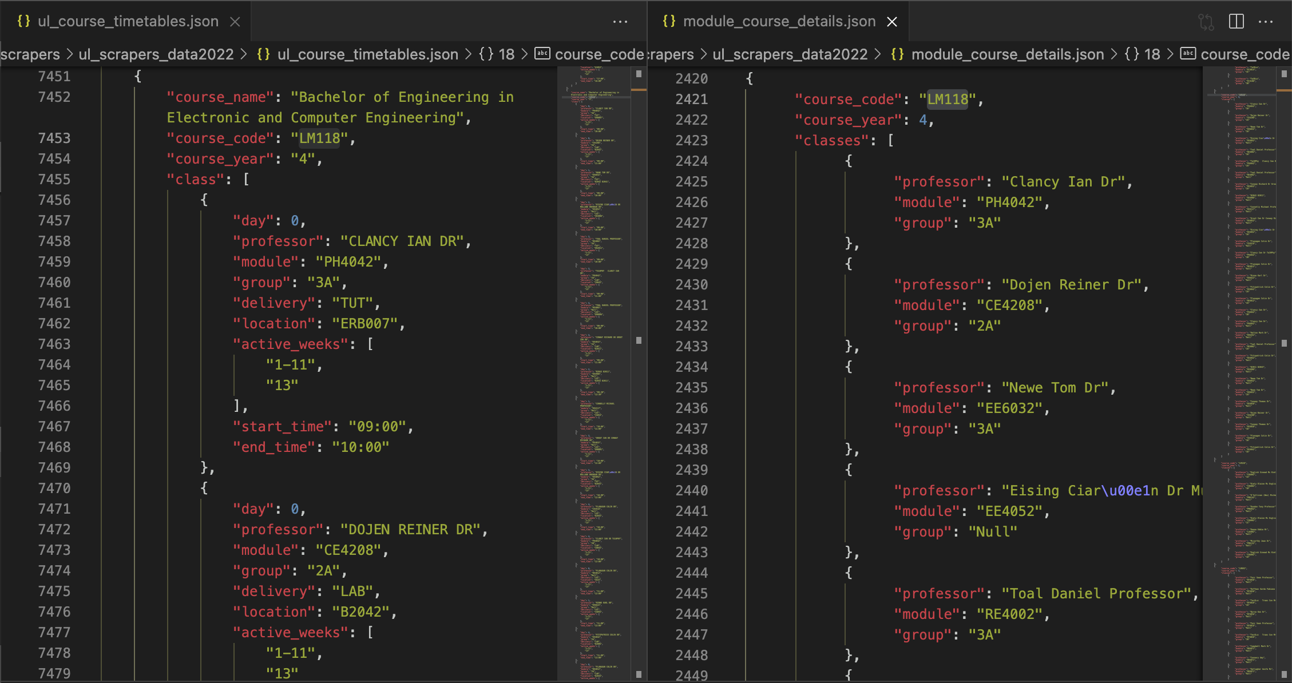
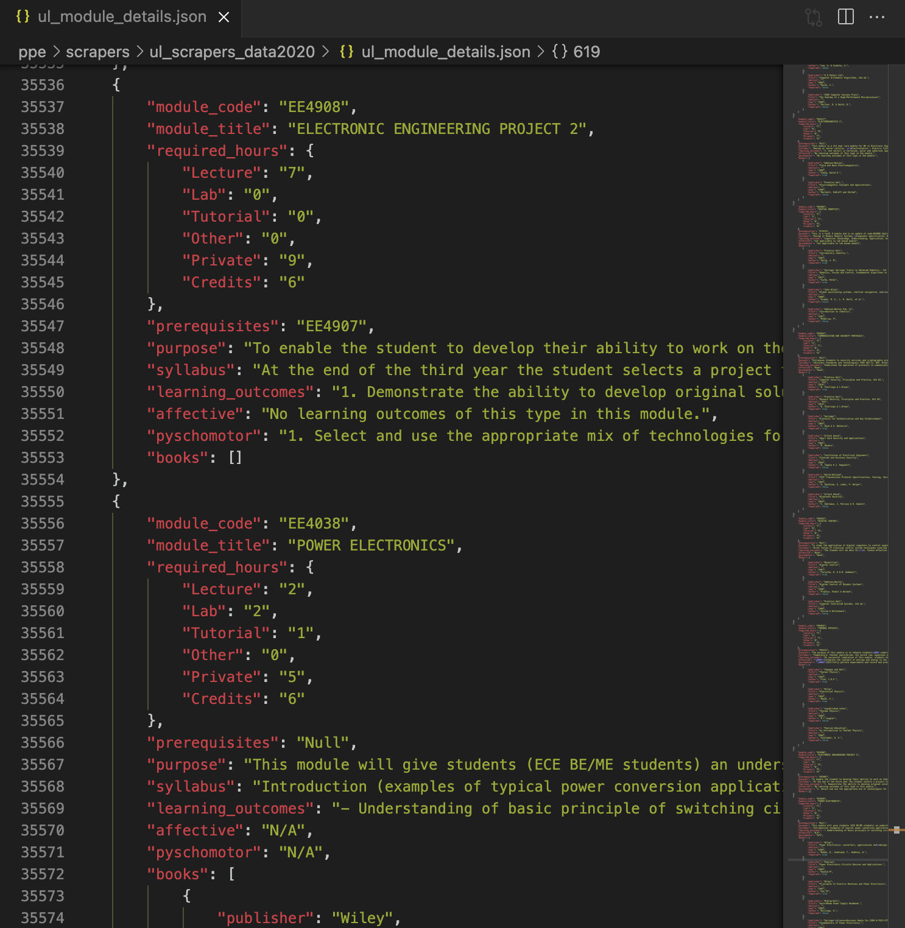
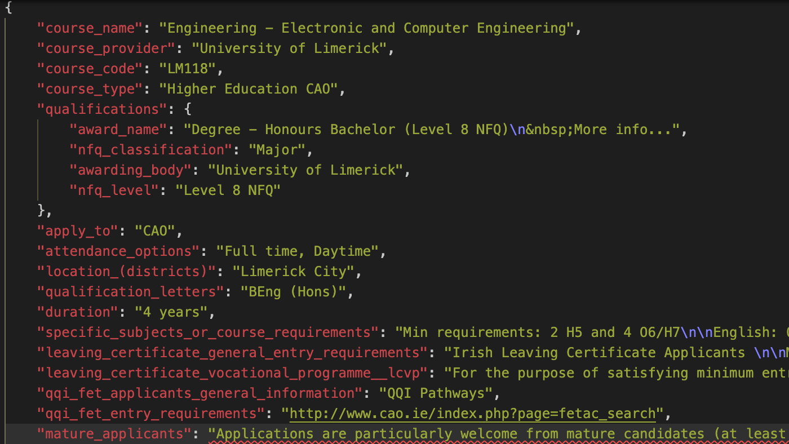
Key results
Extraction of UL data
Extraction of Qualifax data

Slide 8
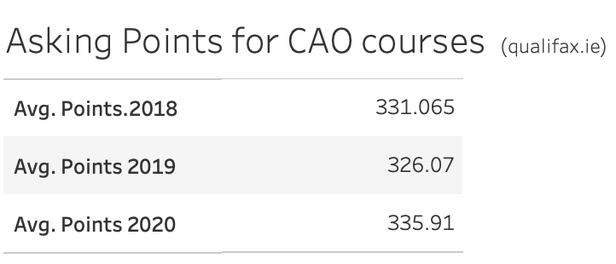
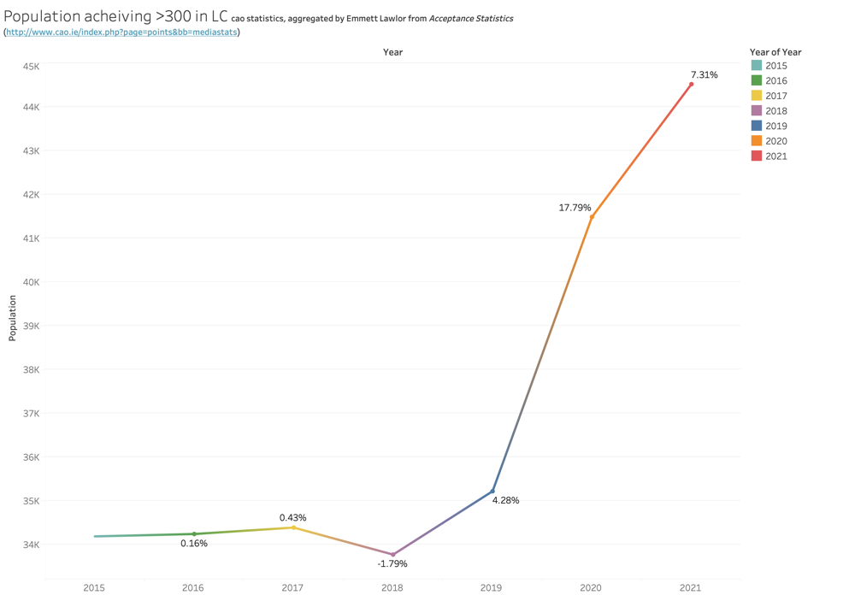
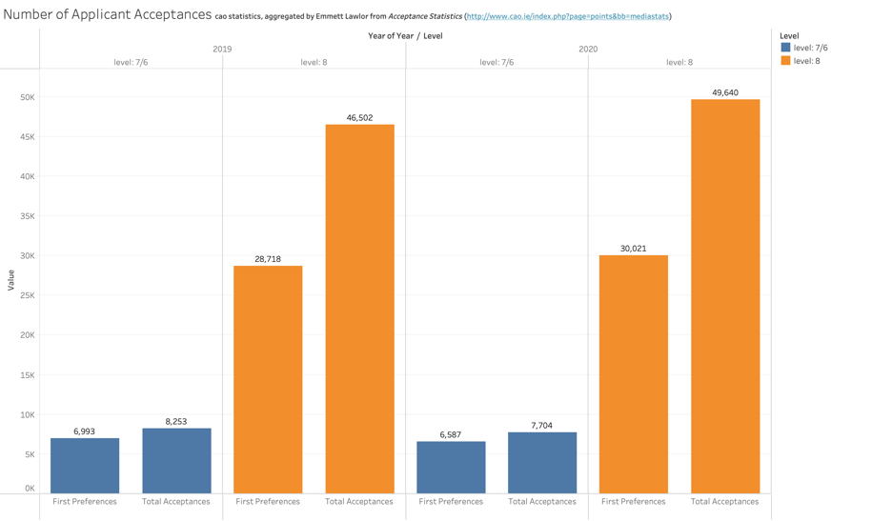
Key results
Possibility for inflation in Third Level

Slide 9
Problems and solutions
Sources from CAO being in PDF tabular form.
Tabula framework for Python.
Inconsistent Data across sources.
UL, CAO both had conflicting data.
Textual Analysis.
More questions than answers.
Information format and consistency.
UL CyberSecurity.
Removed password entry to webapp

Slide 10
Potential uses of the system and future work
Course competitivity.
Utilising scrapers and analysing external sources like Qualifax, institutions can find a competitive edge over other courses or districts, what to offer etc.
A new hub for integrated tools.
Allowing students to create web applications such as the one in this project, under a institution framework with special accesses such as log-in using Institution portal. Institutions could have a flood of resources available, built by students for students or lecturers.
Deter drop-outs, increase quality of student life.
By creating custom tools wrapped around data like Qualifax (course description data), we could build tools to help hopeful students find the right course.
By streamlining student tool creation, students can have newer ways of keeping their digital and physical academic life in check, in ways unknown to corporate software creators.
Helping students find the ideal course and structure around it, we can make a very stressful period in life easier.

Slide 11
Demonstration
Demonstration of Web Application.
Will demonstrate flow
How various aspects were completed.
Evolution.

Slide 12
Conclusions
Quality of code progression.
Third levels beware of strain on institution and community resources.
A need for organisation and formatting of documents.

Slide 13
Thank you. Any questions?

